Slide 1


Default Prediction and Business Insights: American Express
Presented by Deepesh Singh

Slide 2
Introduction:
American Express operates in the financial services industry, specifically in the credit card and payments industry. It is a leading global provider of payment solutions and financial services for consumers, businesses, and merchants.
AmEx offers a range of financial products and services, including credit cards, charge cards, travel services, merchant services, and personal savings products. Its core business is its proprietary card products, which include consumer, small business, and corporate cards.
Despite having a world-class infrastructure and a strong reputation for customer service, AmEx is facing the challenge of customers getting defaulted. This means that some customers are not able to repay their credit card debts on time, resulting in financial losses for AmEx. Defaulted customers are also at risk of losing their credit score, which can make it more difficult for them to obtain credit in the future.
AmEx is aware that they have a vast amount of customer data that could potentially be used to address this challenge. However, they have not been able to make effective use of this data to create measurable economic benefits, such as increased revenue or reduced expenses. Therefore, AmEx has reached out to Global Waterhouse Consulting to develop a roadmap for generating insights from data to help reduce the risk of customer defaults and increase revenue.

Slide 3
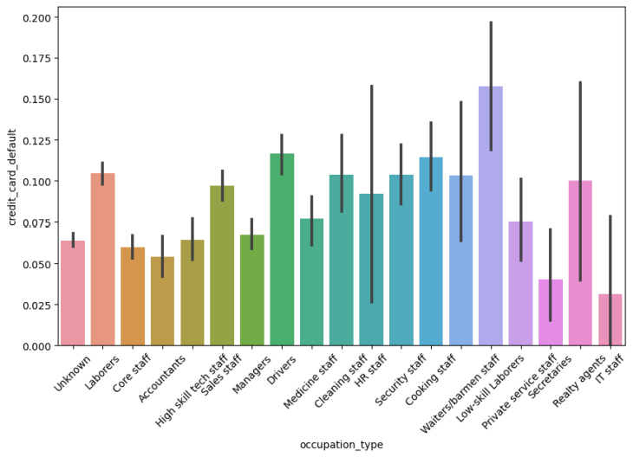
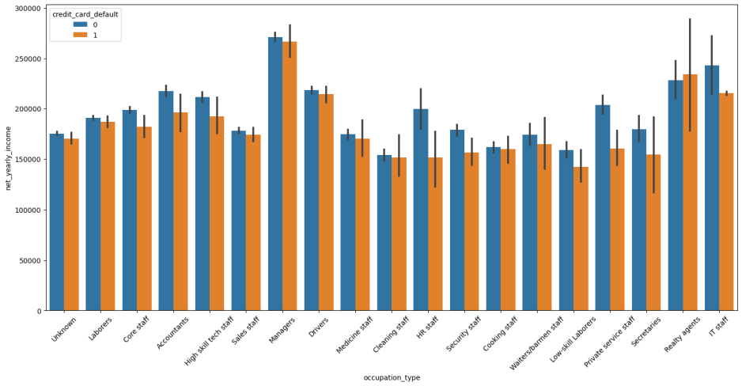
Data Analysis:
To generate insights, the data must first be explored. Finding trends, patterns, and correlations can help identify customer behavior and create a roadmap for the company.
Occupation Type Vs Credit Card Default
Occupation Type Vs Net Yearly Income
"The majority of defaulters belong to the occupation types of laborers, drivers, and waiters/barmen, who typically earn lower incomes."

Slide 4
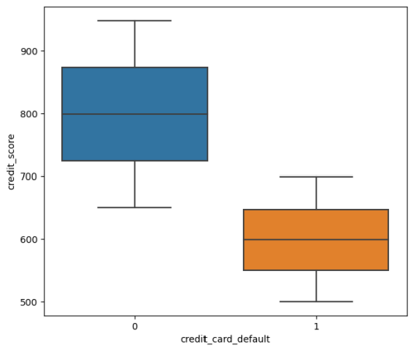
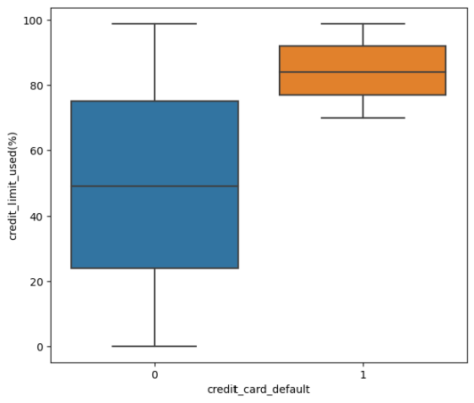
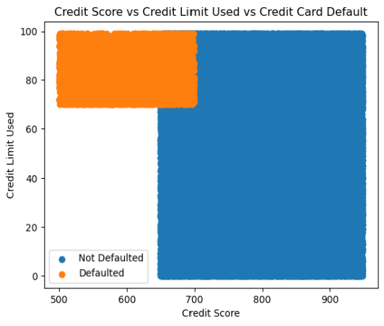
Credit Score
Vs
Credit Card Default
Credit Limit Used
Vs
Credit Card Default
Credit Limit Used Vs Credit Score
Vs
Credit Card Default
"Individuals who default on their credit payments typically have lower credit scores and have utilized 80-100% of their available credit limits."

Slide 5
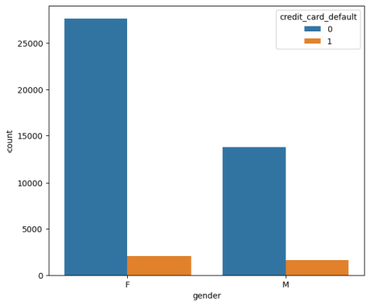
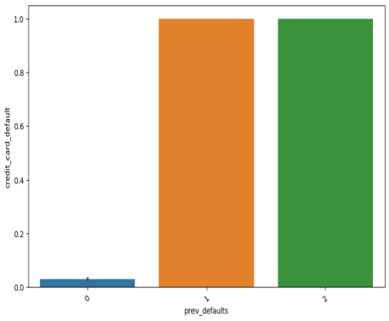
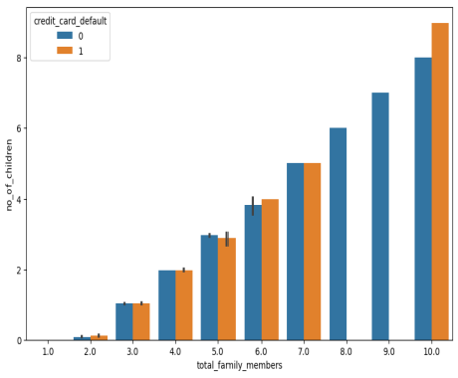
Gender Count
Previous Defaults
Number of Family Members
While females make up the majority of credit card users, statistics show that the number of males who default on their credit card payments is relatively higher.
Past defaulters are more likely to default again in the future.
Families with larger numbers of members and children tend to face difficulties in repaying their credit payments.
"Hence, using these information, American Express can make informed decisions to increase revenue, reduce expenses, and minimize risk."

Slide 6
Building a Predictive Model:
Based on the steps taken in data exploration and understanding, we have determined the crucial variables that have an impact on the risk of default, and we have categorized the historical data as either default or non-default.
With the insights gained from the data exploration and understanding process, we can employ Predictive modelling techniques such as Logistic regression, decision trees, and random forest to identify customers with a high risk of default.
This will enable us to devise strategies aimed at mitigating default risk.

Slide 7
Customer Segmentation:
Amex can use Segmentation Techniques like clustering, factor analysis, and decision trees to identify customer segments based on demographics, spending behavior, and transaction history. By applying these strategies, Amex can group customers based on their common characteristics and behaviors, allowing them to tailor their marketing and service offerings to meet the needs and preferences of each segment.
Insights: Customer segmentation can be beneficial in creating focused marketing campaigns, customized product offerings, and personalized risk management strategies. By segmenting customers based on their demographics, spending behavior, and transaction history, businesses can better understand their needs and preferences and develop targeted approaches to serve them. This can lead to increased customer satisfaction, improved customer retention, and ultimately, greater profitability for the business.

Slide 8
Real-Time Decision Making:
To enhance their operations, Amex should incorporate real-time data processing capabilities and integrate predictive modeling and customer segmentation into their decision-making process. This can be achieved through the use of real-time decision-making techniques such as decision support systems, business intelligence tools, and data visualization.
Insights: Implementing real-time decision-making techniques can offer several benefits to Amex, such as reducing the risk of defaults, increasing revenue, and enhancing customer satisfaction.

Slide 9
Interpreting the Result:
To identify patterns in customer behavior, preferences, and spending habits from AmEx data, we can perform exploratory data analysis techniques such as descriptive statistics and data visualization. Here are some examples of the patterns that we can identify:
Targeted Marketing and Risk Assessment: AmEx can use targeted marketing strategies to reach out to specific occupation types and income brackets to offer them credit products that suit their financial capabilities. Additionally, they can also assess the risk profiles of these customers to determine their creditworthiness and the credit limits they can handle.
Credit Limit Adjustments: AmEx can adjust the credit limits of individuals who have utilized 80-100% of their available credit limits. Lowering credit limits to manageable levels can reduce the risk of default and increase the chances of successful repayment.
Credit Education: They can offer credit education to customers, especially those in occupation types with higher default rates. This education could include information about managing finances, budgeting, and using credit responsibly.
Family-oriented Products: Also can design family-oriented credit products that cater to larger households with children. These products could include features such as lower interest rates, rewards for spending on family expenses, and flexible repayment options.
Collections and Debt Management: At last, AmEx can use effective collections and debt management strategies to recover debts from past defaulters. This can include offering debt settlement options and debt restructuring plans that are flexible and sustainable.
"Overall, American Express can use a combination of these solutions to address the challenges of credit defaults and create sustainable credit products for their customers."

Slide 10
Future Scope of Work:
While the above recommendations are a good starting point, there are additional steps that American Express can take to further improve their predictive models and marketing campaigns. These steps include:
Incorporating external data sources: American Express can improve their predictive models by incorporating external data sources, such as economic data or social media data.
Advanced analytics techniques: American Express can use advanced analytics techniques such as machine learning and artificial intelligence to create more accurate predictive models.
Real-time analysis: American Express can use real-time analysis to quickly identify changes in customer behavior and respond proactively.
Experimentation: American Express should conduct experiments to test the effectiveness of different marketing campaigns and strategies, and use the results to refine their approach over time.

